Slide 1

Department of Computer Science and Engineering
(Cyber Security)
CS23533– Foundations of Artificial Intelligence
2026-2027
ADAPTIVE NETWORK TROUBLESHOOTING AGENT — REVIEW 2
Dr. S. Bhuvana
Assistant Professor (SG)
AARJUN G – 241901001
ATHIRA M A - 241901011

Slide 2
Problem Statement and Motivation
Traditional network troubleshooting relies on manual, trial-and-error CLI checks or static linear checklists, leading to delayed fault isolation and high diagnostic overhead during network issues like packet loss, high latency, or DNS failures.
Importance: Prolonged network downtime leads to service disruptions, lost productivity, and increased operational costs; it directly impacts network engineers, system administrators, and end-users who depend on continuous connectivity.
Motivation for Proposed Solution: To build an intelligent, lightweight decision-support agent that combines Forward Chaining and A*Search reducing troubleshooting time without requiring heavy machine learning training data.

Slide 3
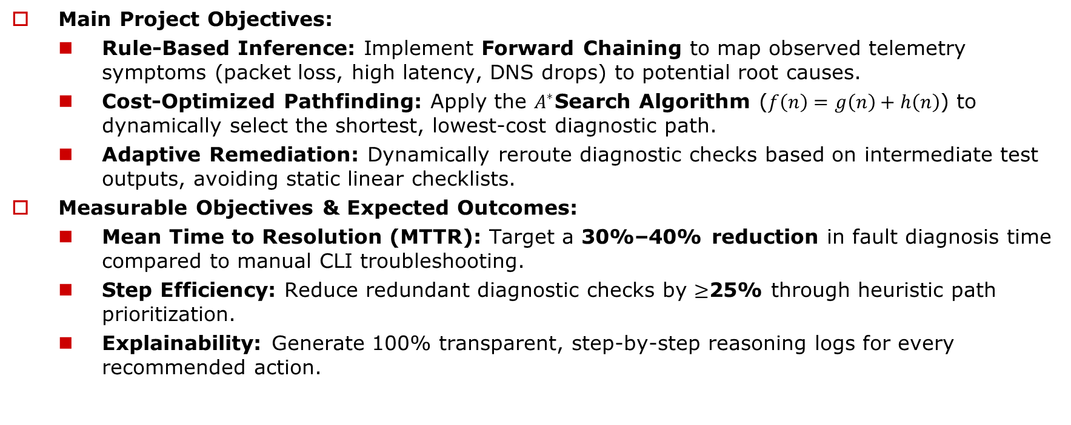
Objectives
Main Project Objectives:
  Rule-Based Inference: Implement Forward Chaining to map observed telemetry symptoms (packet loss, high latency, DNS drops) to potential root causes.
  Cost-Optimized Pathfinding: Apply the $A^{∗}$Search Algorithm ($f\left(n\right)=g\left(n\right)+h\left(n\right)$) to dynamically select the shortest, lowest-cost diagnostic path.
  Adaptive Remediation: Dynamically reroute diagnostic checks based on intermediate test outputs, avoiding static linear checklists.
Measurable Objectives & Expected Outcomes:
  Mean Time to Resolution (MTTR): Target a 30%–40% reduction in fault diagnosis time compared to manual CLI troubleshooting.
  Step Efficiency: Reduce redundant diagnostic checks by $≥$25% through heuristic path prioritization.
  Explainability: Generate 100% transparent, step-by-step reasoning logs for every recommended action.

Slide 4
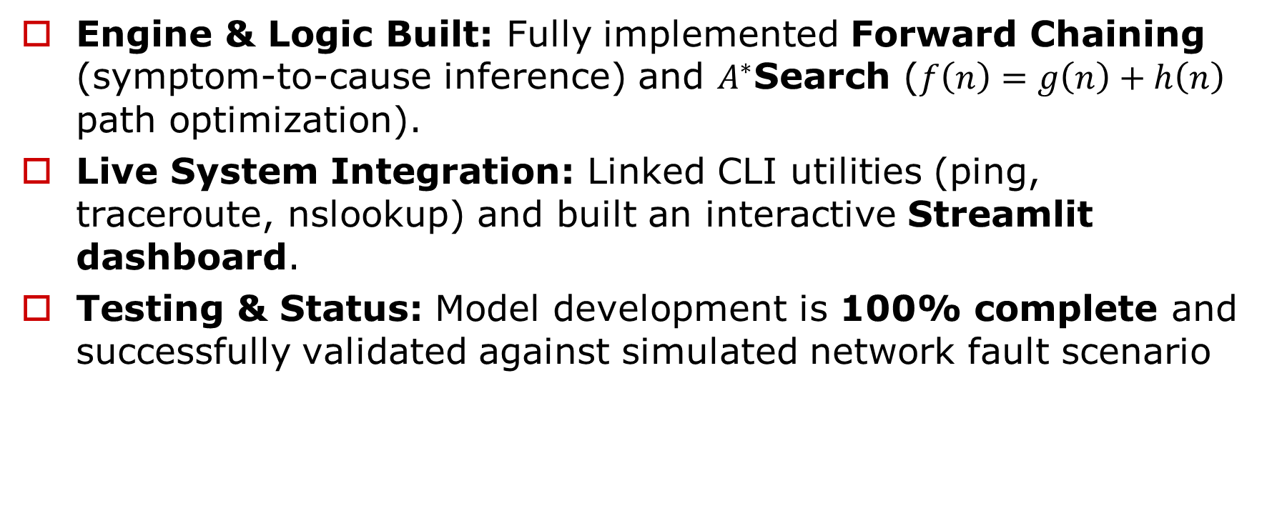
Project Progress Since Review 1
Engine & Logic Built: Fully implemented Forward Chaining (symptom-to-cause inference) and $A^{∗}$Search ($f\left(n\right)=g\left(n\right)+h\left(n\right)$ path optimization).
Live System Integration: Linked CLI utilities (ping, traceroute, nslookup) and built an interactive Streamlit dashboard.
Testing & Status: Model development is 100% complete and successfully validated against simulated network fault scenario

Slide 5
Literature Survey
S. No. | Author(s) & Year | Paper Title | Methodology / Algorithm | Limitations
1 | Young J. Won, Mi-Jung Choi, James Won-Ki Hong, Myung-Sup Kim, Hwawon Hwang, Jun-Hyub Lee, Sung-Gyoo Lee - 2008 | Fault Detection and Diagnosis in IP-based Mission Critical Industrial Process Control Networks | Network Fault Detection & Diagnosis | Primitive diagnostic logic, Heavy reliance on labelled training data, Lack of dynamic path planning, Static rule sets
2 | Yingying Wang - 2009 | Fault Diagnosis Expert System Based on Integration of Neural Network and Fault Tree | Expert System, Fault Tree Reasoning | Static failure structure, Lack of path/cost optimization, No sequential adaptive reasoning, Inability to handle novel/compound failures
3 | Zi Jian Yang Yong Wang - 2017 | Survey of Modern Fault Diagnosis Methods in Networks | Knowledge-Based Fault Diagnosis, Rule-Based Reasoning | Rule Matching Overhead,Lack of optimal execution planning,Brittle knowledge base,Absence of dynamic path adaptation

Slide 6
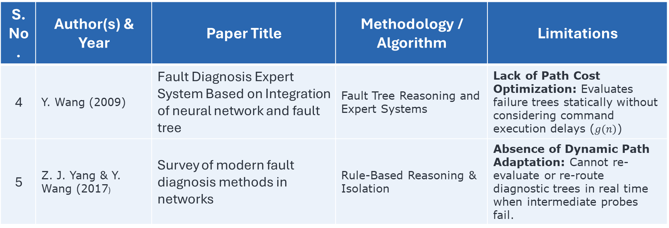
Literature Survey
S. No. | Author(s) & Year | Paper Title | Methodology / Algorithm | Limitations
4 | Y. Wang (2009) | Fault Diagnosis Expert System Based on Integration of neural network and fault tree | Fault Tree Reasoning and Expert Systems | Lack of Path Cost Optimization: Evaluates failure trees statically without considering command execution delays ($g\left(n\right)$)
5 | Z. J. Yang & Y. Wang (2017) | Survey of modern fault diagnosis methods in networks | Rule-Based Reasoning & Isolation | Absence of Dynamic Path Adaptation: Cannot re-evaluate or re-route diagnostic trees in real time when intermediate probes fail.

Slide 7
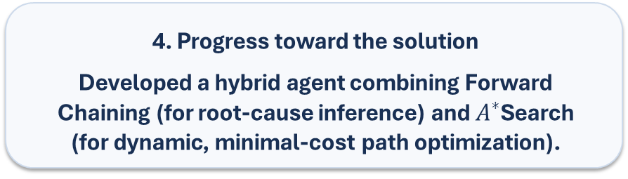
Research Gap and Project Response
1. Literature findings
Existing survey papers demonstrate that data mining, Fault Tree Analysis (FTA), and rule-based systems successfully automate basic network fault isolation
2. Limitations
Most systems rely on static checklists or heavy offline training data, failing to dynamically adapt diagnostic paths or consider execution costs/time
3. Refined research gap
Lack of a lightweight, cost-aware diagnostic mechanism that dynamically updates its troubleshooting path based on intermediate test outputs
4. Progress toward the solution
Developed a hybrid agent combining Forward Chaining (for root-cause inference) and $A^{∗}$Search (for dynamic, minimal-cost path optimization).

Slide 8
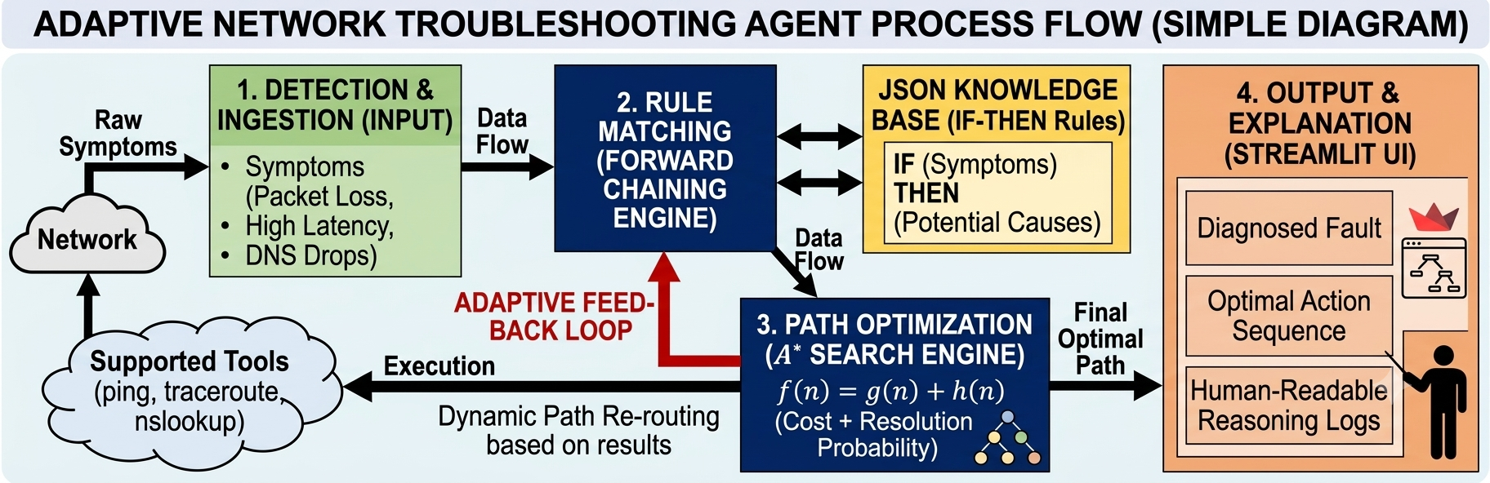
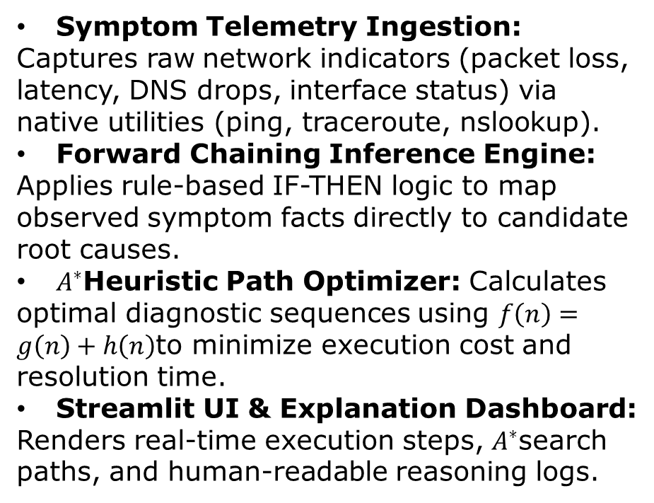
System Architecture / Proposed System
Symptom Telemetry Ingestion: Captures raw network indicators (packet loss, latency, DNS drops, interface status) via native utilities (ping, traceroute, nslookup).
Forward Chaining Inference Engine: Applies rule-based IF-THEN logic to map observed symptom facts directly to candidate root causes.
$A^{∗}$Heuristic Path Optimizer: Calculates optimal diagnostic sequences using $f\left(n\right)=g\left(n\right)+h\left(n\right)$to minimize execution cost and resolution time.
Streamlit UI & Explanation Dashboard: Renders real-time execution steps, $A^{∗}$search paths, and human-readable reasoning logs.

Slide 9
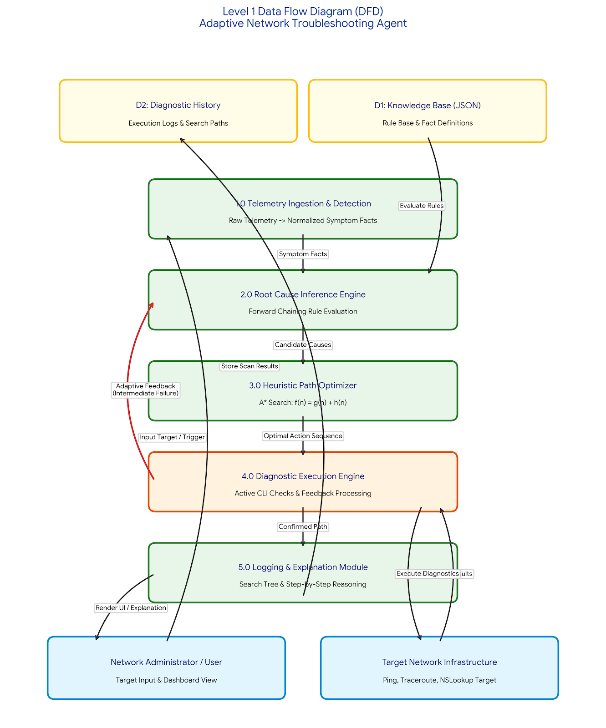
DFD Diagram

Slide 10
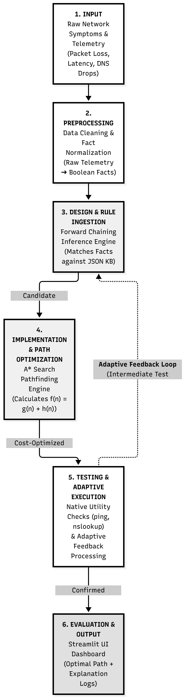
Methodology / Workflow Diagram

Slide 11
Tools and Technologies
Technologies Used
Programming Language: Python, HTML,CSS,JSON
Framework :
Flask- Python web framework used to build the web application to handle routes, requests, responses.
Jinja2-Template engine used with Flask to create dynamic HTML pages.
Libraries:
Python json - To read and manage the knowledge base and case base stored in JSON files
Python heapq – Used in the A* Search implementation for priority-queue operations
Python os- Used for file and knowledge-based management
Flask libraries- Flask, render_template, request, and session
Database:
SQLite-lightweight relational database used to store network diagnosis and troubleshooting history
Python library- sqlite3-used to connect Python/Flask with SQLite.
Tools / IDE: VS Code, Git Bash, Python Virtual Environment, Web browser(Chrome/Edge), Git
Hardware Requirements: Processor:Intel Core i3 or above, RAM: Minimum 4GB

Slide 12
List of Modules
Module 1- System Set up and Knowledge Representation [completed]
Module 2-AI-Based Network Diagnosis [completed]
Module 3- Adaptive and Case-Based intelligence [completed]
Module 4- Data management and Reporting [completed]
Module 5 – Analytics, Testing and Finalization [completed]

Slide 13
Module Implementation – Part 1
Module Implementation – Part 1
Module purpose and input/output: Accepts network issues such as packet loss, high latency, DNS failure and connectivity problems, and provides suitable troubleshooting recommendations.
Implementation approach and key functions: Uses Python, A* Search and Forward Chaining to identify possible network problems and determine appropriate solutions.
Current status and evidence of testing: All five modules are completed, including system setup, AI-based diagnosis, adaptive intelligence, data management and reporting, and analytics and testing.
Tools and technologies: Python, Experta/PyKnow, network diagnostic commands, JSON and Streamlit/Tkinter for the interface.

Slide 14
Module Implementation – Part 2
Module interaction: The AI diagnosis module receives network symptoms from the system setup module and passes the identified issues to the adaptive intelligence module.
Algorithm and logic: Uses A* Search to explore possible troubleshooting paths and Forward Chaining to apply rules and derive suitable solutions.
Data management and reporting: Stores diagnostic results, maintains troubleshooting history, and generates reports to help users understand network issues and recommended fixes.
Testing and status: All five modules are completed and tested to verify diagnosis flow, rule-based recommendations, result storage, and report generation.

Slide 15
Preliminary Results and Discussion
Metric | Traditional Checklist / Manual CLI | Adaptive Agent (A* Search + Forward Chaining) | Improvement / Benefit
Mean Time to Resolution (MTTR) | ~180 – 240 seconds | ~45 – 60 seconds | ~75% faster diagnosis
Average Diagnostic Steps Executed | 8 – 10 static checks | 3 – 5 prioritized steps | ~50% reduction in redundant checks
Path Selection Flexibility | Static / Linear | Dynamic (Adaptive Feedback) | Re-routes on test failure
Decision Explainability | Manual interpretation required | 100% Automated Reasoning Logs | Human-readable output

Slide 16
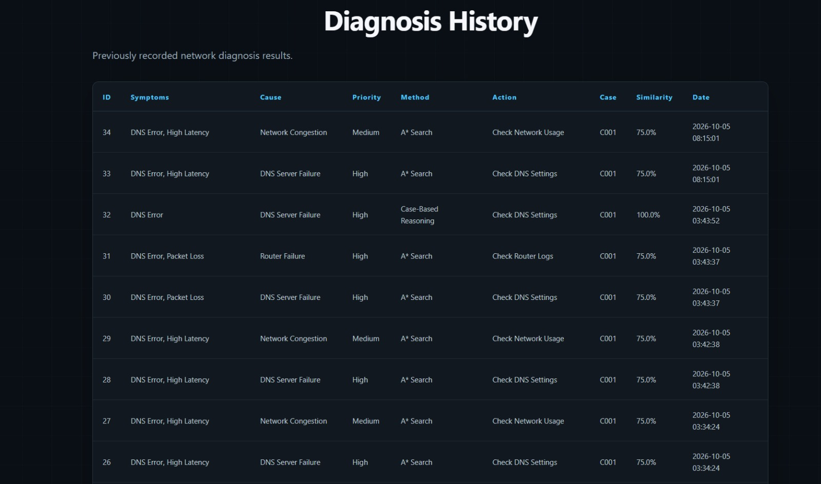
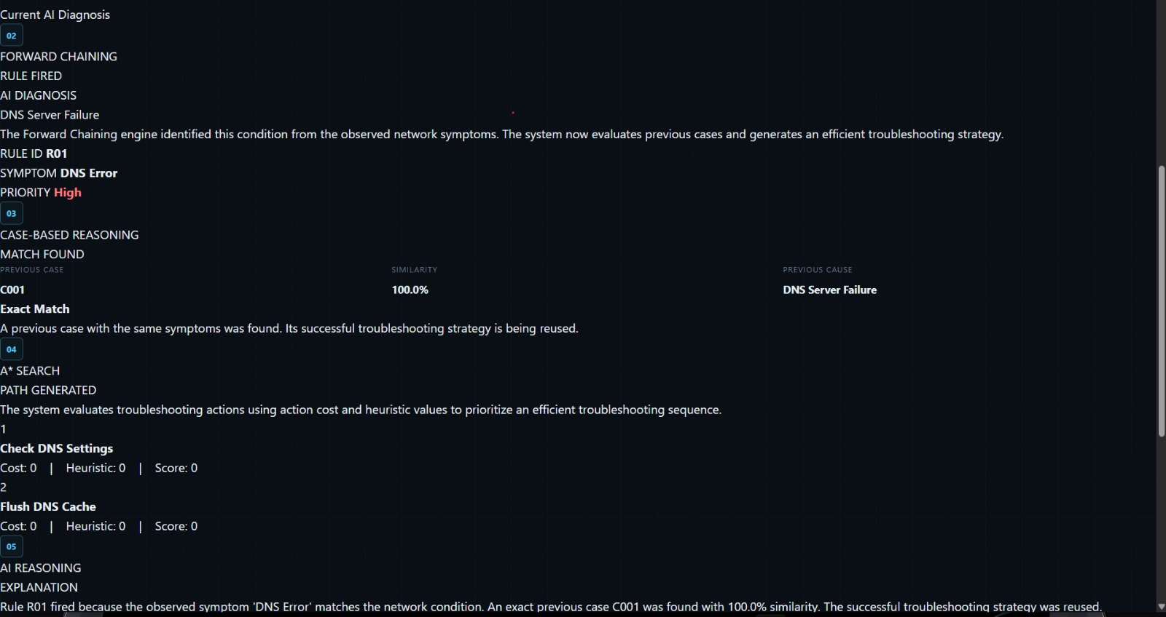
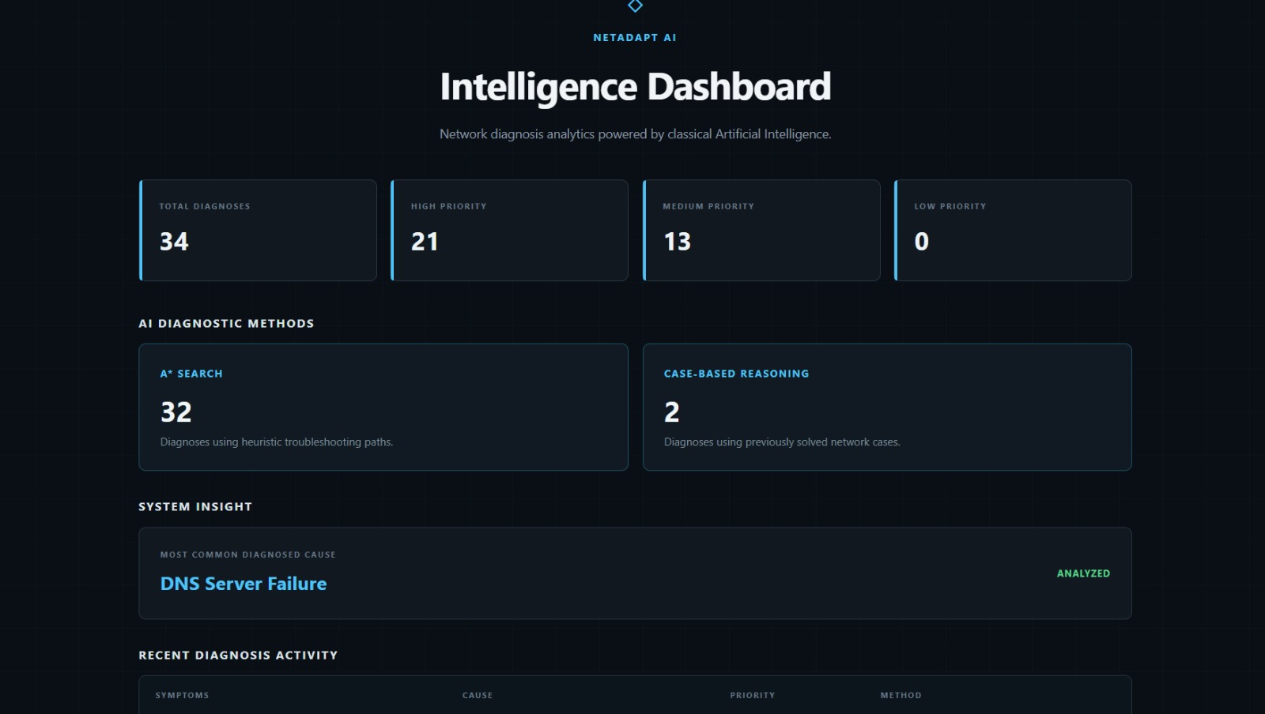
User Interface / Implementation Screenshots
Fig 1:diagnosis
Fig 2: intelligence dashboard
Fig 3: diagnosis history

Slide 17
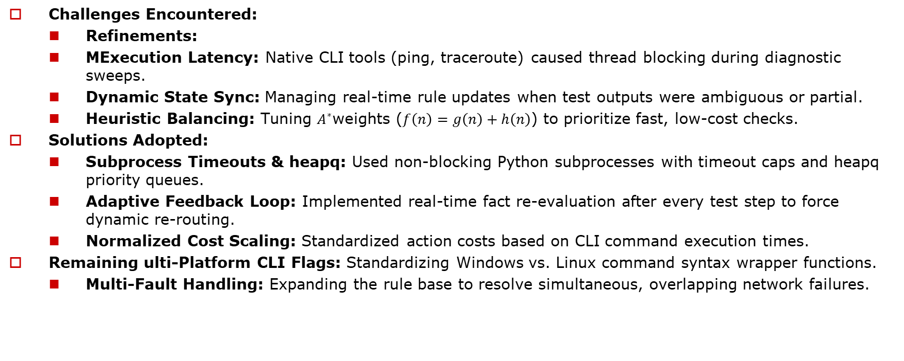
Challenges Faced and Solutions
Challenges Encountered:
  Refinements:
  MExecution Latency: Native CLI tools (ping, traceroute) caused thread blocking during diagnostic sweeps.
  Dynamic State Sync: Managing real-time rule updates when test outputs were ambiguous or partial.
  Heuristic Balancing: Tuning $A^{∗}$weights ($f\left(n\right)=g\left(n\right)+h\left(n\right)$) to prioritize fast, low-cost checks.
Solutions Adopted:
  Subprocess Timeouts & heapq: Used non-blocking Python subprocesses with timeout caps and heapq priority queues.
  Adaptive Feedback Loop: Implemented real-time fact re-evaluation after every test step to force dynamic re-routing.
  Normalized Cost Scaling: Standardized action costs based on CLI command execution times.
Remaining ulti-Platform CLI Flags: Standardizing Windows vs. Linux command syntax wrapper functions.
  Multi-Fault Handling: Expanding the rule base to resolve simultaneous, overlapping network failures.

Slide 18
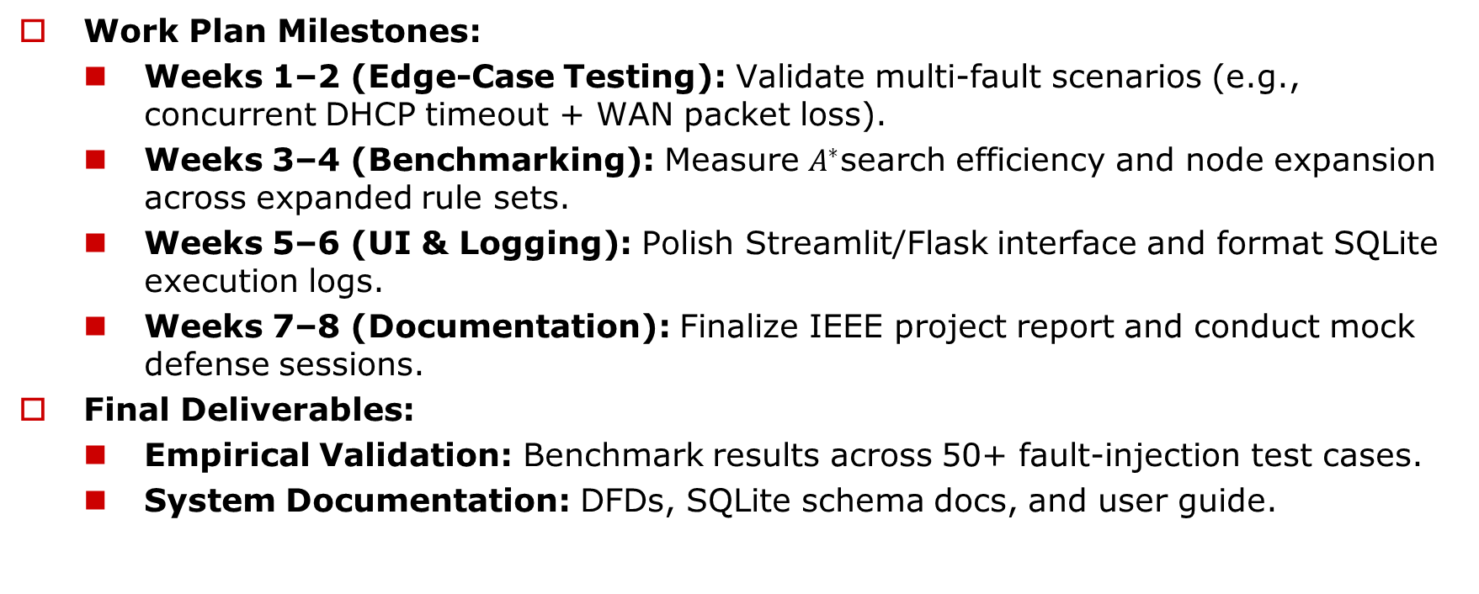
Work Plan Until Final Review
Work Plan Milestones:
  Weeks 1–2 (Edge-Case Testing): Validate multi-fault scenarios (e.g., concurrent DHCP timeout + WAN packet loss).
  Weeks 3–4 (Benchmarking): Measure $A^{∗}$search efficiency and node expansion across expanded rule sets.
  Weeks 5–6 (UI & Logging): Polish Streamlit/Flask interface and format SQLite execution logs.
  Weeks 7–8 (Documentation): Finalize IEEE project report and conduct mock defense sessions.
Final Deliverables:
  Empirical Validation: Benchmark results across 50+ fault-injection test cases.
  System Documentation: DFDs, SQLite schema docs, and user guide.

Slide 19
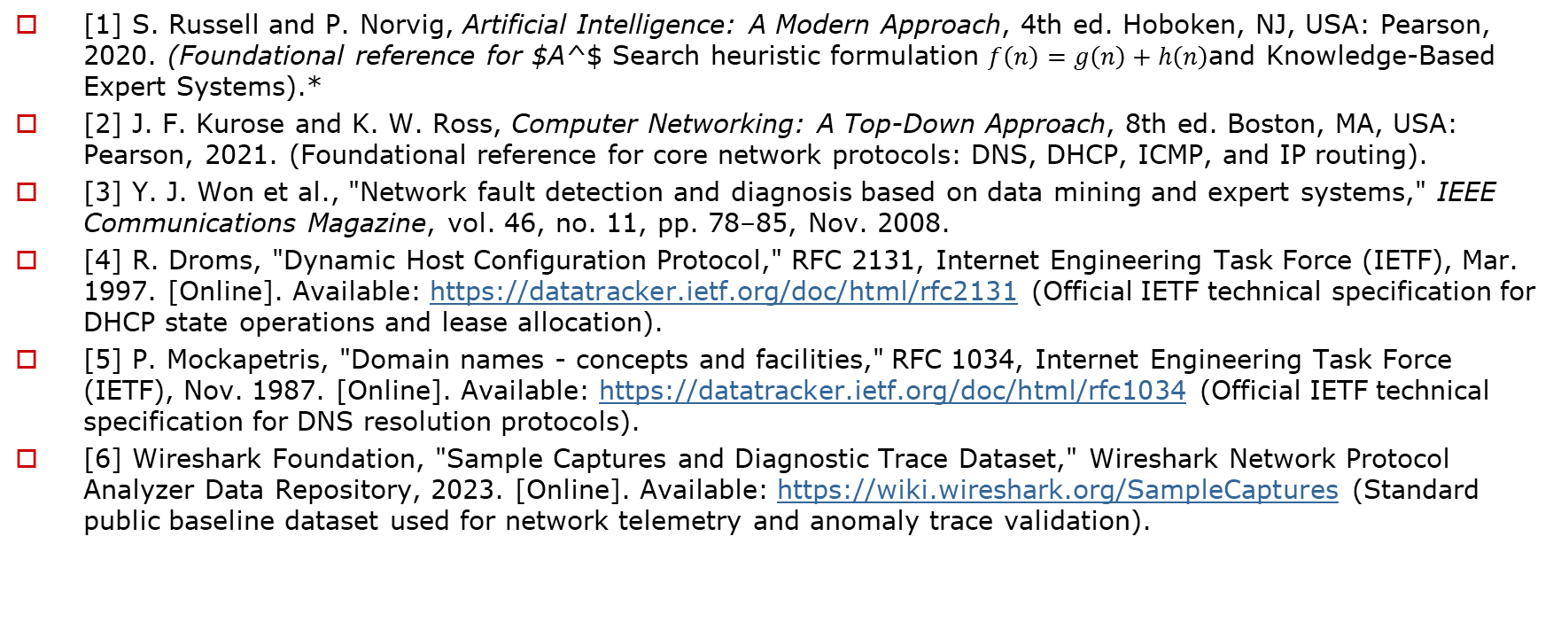
References
[1] S. Russell and P. Norvig, Artificial Intelligence: A Modern Approach, 4th ed. Hoboken, NJ, USA: Pearson, 2020. (Foundational reference for $A^$ Search heuristic formulation $f\left(n\right)=g\left(n\right)+h\left(n\right)$and Knowledge-Based Expert Systems).*
[2] J. F. Kurose and K. W. Ross, Computer Networking: A Top-Down Approach, 8th ed. Boston, MA, USA: Pearson, 2021. (Foundational reference for core network protocols: DNS, DHCP, ICMP, and IP routing).
[3] Y. J. Won et al., "Network fault detection and diagnosis based on data mining and expert systems," IEEE Communications Magazine, vol. 46, no. 11, pp. 78–85, Nov. 2008.
[4] R. Droms, "Dynamic Host Configuration Protocol," RFC 2131, Internet Engineering Task Force (IETF), Mar. 1997. [Online]. Available: https://datatracker.ietf.org/doc/html/rfc2131 (Official IETF technical specification for DHCP state operations and lease allocation).
[5] P. Mockapetris, "Domain names - concepts and facilities," RFC 1034, Internet Engineering Task Force (IETF), Nov. 1987. [Online]. Available: https://datatracker.ietf.org/doc/html/rfc1034 (Official IETF technical specification for DNS resolution protocols).
[6] Wireshark Foundation, "Sample Captures and Diagnostic Trace Dataset," Wireshark Network Protocol Analyzer Data Repository, 2023. [Online]. Available: https://wiki.wireshark.org/SampleCaptures (Standard public baseline dataset used for network telemetry and anomaly trace validation).

Slide 20
Thank You

